Slide 1

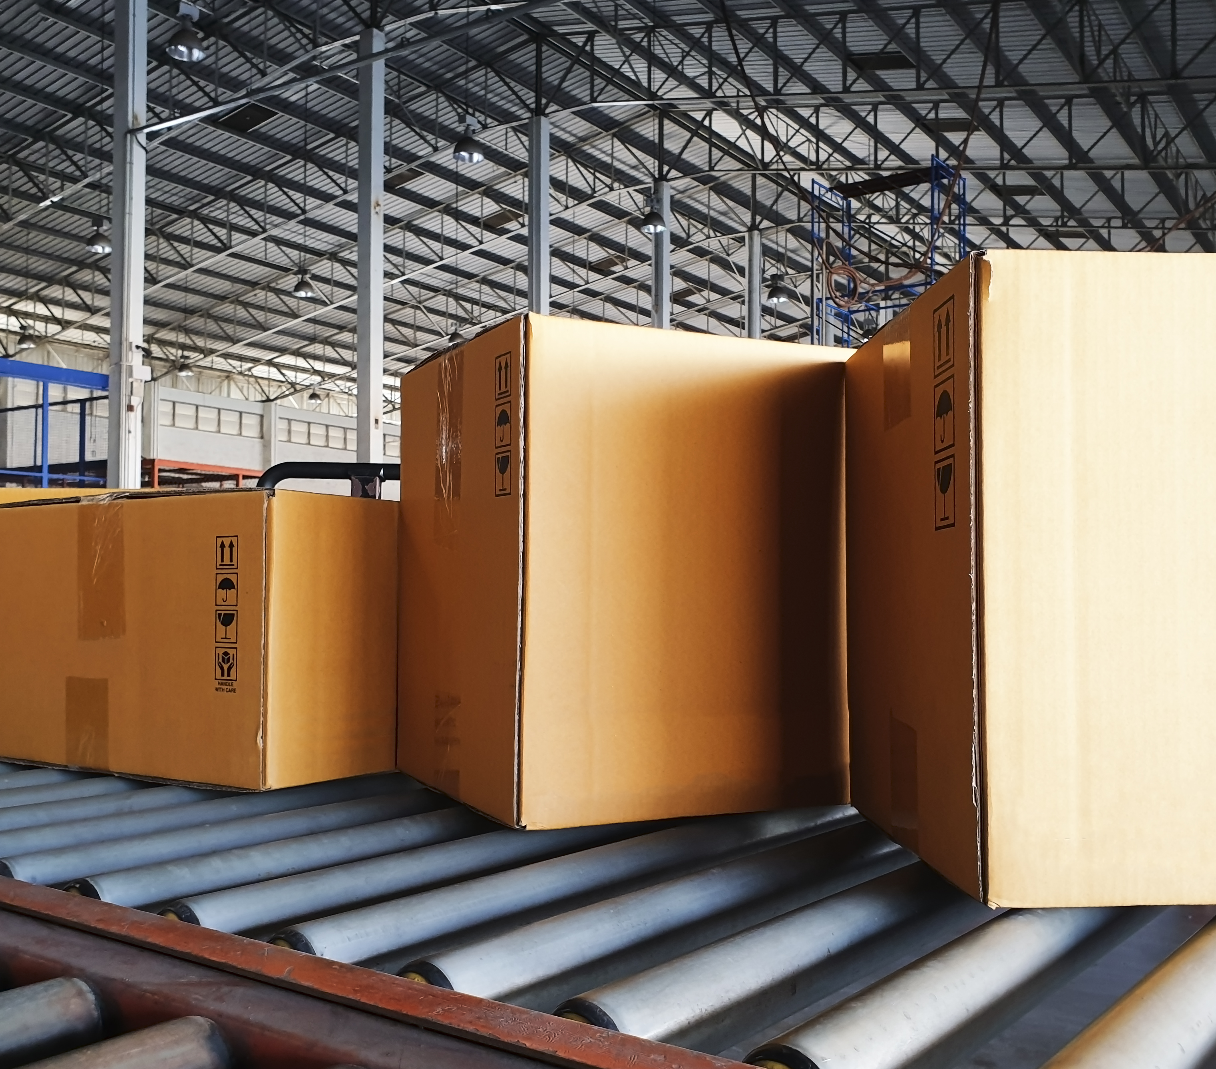
SESSION 3
Let’s Sort

Slide 2
Guiding Questions
Can you build a LEGO® robot and code a solution?
How do you change the program so the LEGO robot plays a light or sound?
Outcomes
The team will build and code the LEGO® robot and then change the program.
The team will build the sorting center and explore how cargo is sorted.
How can you make sure cargo is sorted correctly?
Can you build ways to load and unload cargo?
Notes:
Each session has Guiding Questions that can be shared to frame the session.
Session Tips
The team will learn about and use light and sound blocks.
Challenges are provided for the team to go further with their robot.
The Solution space can be used to write down the coding steps planned or which coding blocks the team will change.​
The team will need Book 2 and Bag 2 located in the Explore set.
Connect to telling time by sharing that turning the crank right is clockwise and turning it left is counterclockwise.

Slide 3



Introduction – Let’s Have Fun
Examples of Fun
Ask the students to provide examples of Fun and record them here
Example of Fun
Example of Fun
We enjoyed and celebrated what we did!
Extension
Notes:
Introduction
Let’s Have Fun
(10 minutes)
• Read the definition for fun to the team. (see page 5)
• Talk about what fun is. Have the team provide examples of this Core Value.
• Extension: Have everyone draw a picture of an example of fun on the Core Values page in their Engineering Notebook.

Slide 4


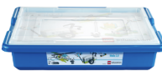
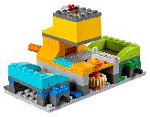
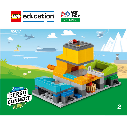
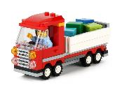
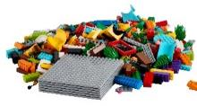
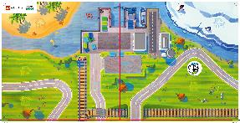
Task 1
You need…
Open the WeDo 2.0 app. Find your lesson.
Can you code the robot to play a different sound or flash a light? Explain your solution.
Change the existing program based on your ideas. Test it out!
Classroom Projects:
Spy Robot
Notes:
Tasks (20 minutes)
Open the WeDo 2.0 app. Find your lesson.
Can you code the robot to play a different sound or flash a light? Explain your solution.
Change the existing program based on your ideas. Test it out!
Challenge
Can you make the robot flash a different color or move?
Change the robot and play your program.

Slide 5
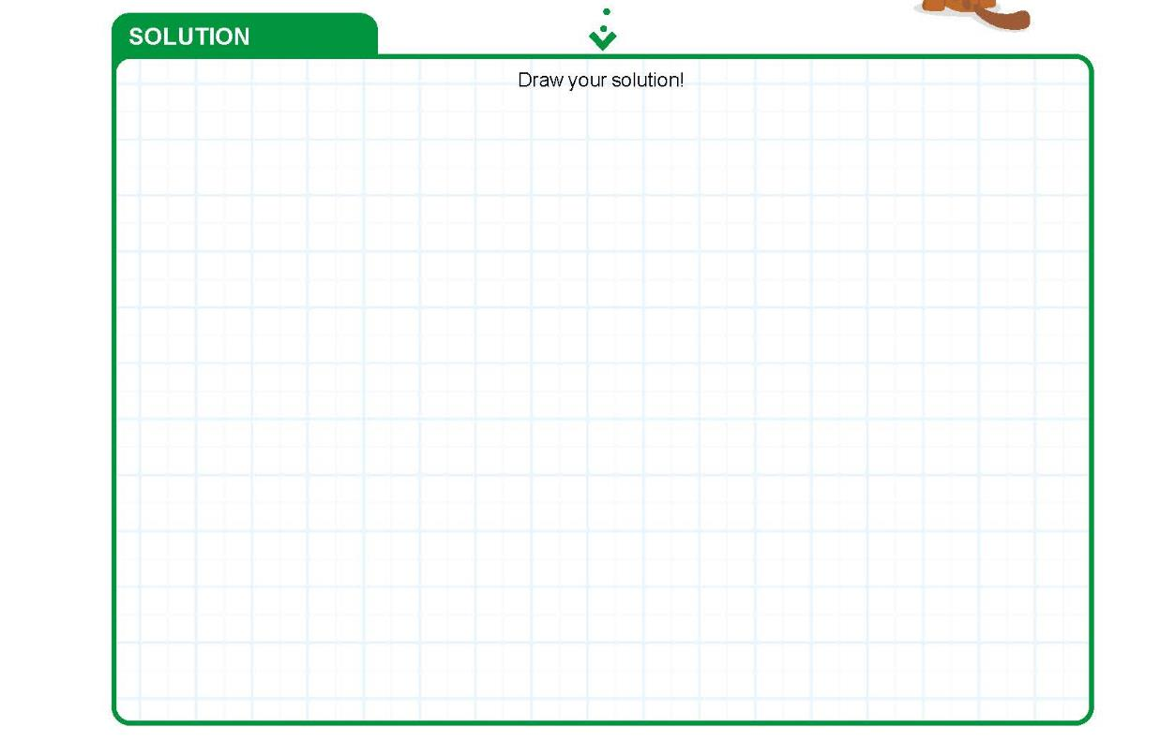
Task 1
Notes:
Tasks (20 minutes)
Open the WeDo 2.0 app. Find your lesson.
Can you code the robot to play a different sound or flash a light? Explain your solution.
Change the existing program based on your ideas. Test it out!
Challenge
Can you make the robot flash a different color or move?
Change the robot and play your program.

Slide 6
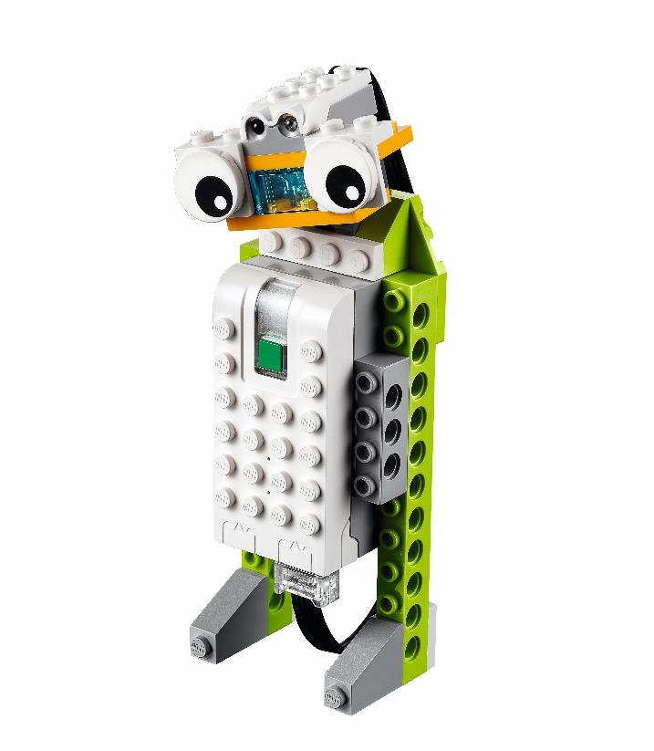
Task 1
Challenge
Can you make the robot flash a different color or move?
Change the robot and play your program.
Notes:
Tasks (20 minutes)
Open the WeDo 2.0 app. Find your lesson.
Can you code the robot to play a different sound or flash a light? Explain your solution.
Change the existing program based on your ideas. Test it out!
Challenge
Can you make the robot flash a different color or move?
Change the robot and play your program.

Slide 7
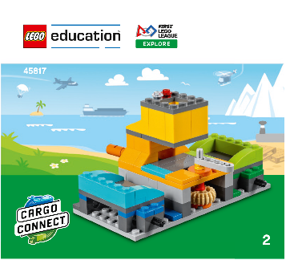

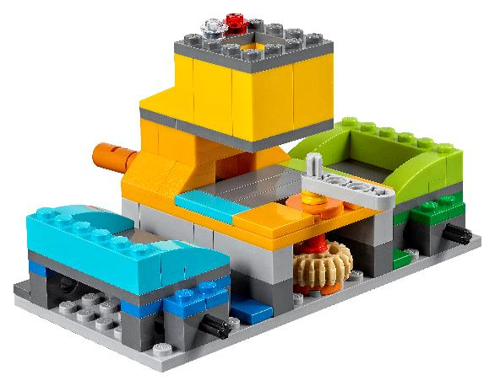
Task 2
Follow the building instructions in Book 2 to make the sorting center.
Place the sorting center on the mat.
Notes:
Tasks (20 minutes)
Follow the building instructions in Book 2 to make the sorting center.
Place the sorting center on the mat.
Think of ways to help Ruby and Jacob.
Try out the sorting center!
Turn the crank to the right to sort the green cargo to the green bin.
Turn the crank to the left to sort the blue cargo to the blue bin.
Brainstorm and share your ideas for how the sorted cargo is loaded for transport to its next destination.

Slide 8
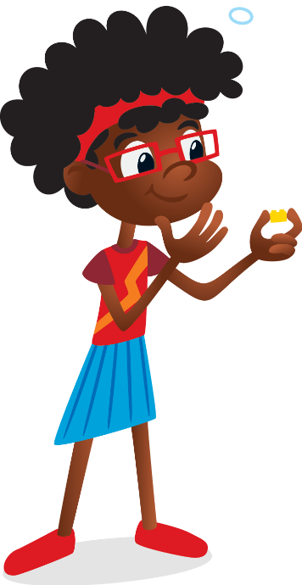
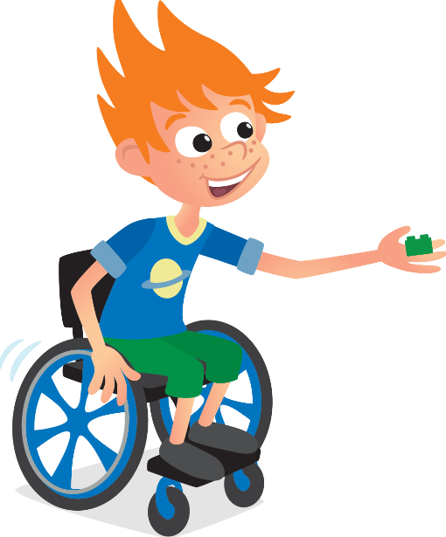
Task 2
Think of ways to help Ruby and Jacob.
How is the
cargo sorted into the
correct bins?
How is cargo
loaded and
unloaded at the
sorting center?
Notes:
Tasks (20 minutes)
Follow the building instructions in Book 2 to make the sorting center.
Place the sorting center on the mat.
Think of ways to help Ruby and Jacob.
Try out the sorting center!
Turn the crank to the right to sort the green cargo to the green bin.
Turn the crank to the left to sort the blue cargo to the blue bin.
Brainstorm and share your ideas for how the sorted cargo is loaded for transport to its next destination.

Slide 9

Task 2
Try out the sorting center!
Turn the crank to the right to sort the green cargo to the green bin.
Turn the crank to the left to sort the blue cargo to the blue bin.
Notes:
Tasks (20 minutes)
Follow the building instructions in Book 2 to make the sorting center.
Place the sorting center on the mat.
Think of ways to help Ruby and Jacob.
Try out the sorting center!
Turn the crank to the right to sort the green cargo to the green bin.
Turn the crank to the left to sort the blue cargo to the blue bin.
Brainstorm and share your ideas for how the sorted cargo is loaded for transport to its next destination.

Slide 10
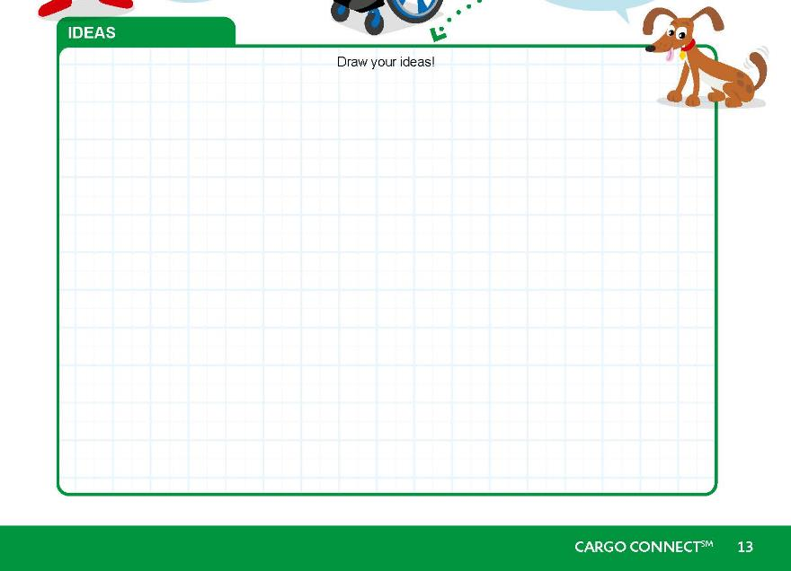
Task 2
Brainstorm and share your ideas for how the sorted cargo is loaded for transport to its next destination.
Notes:
Tasks (20 minutes)
Follow the building instructions in Book 2 to make the sorting center.
Place the sorting center on the mat.
Think of ways to help Ruby and Jacob.
Try out the sorting center!
Turn the crank to the right to sort the green cargo to the green bin.
Turn the crank to the left to sort the blue cargo to the blue bin.
Brainstorm and share your ideas for how the sorted cargo is loaded for transport to its next destination.

Slide 11

Share
Share what you did in the session.
Show the coding skills you learned.
Explain how you changed the program.
Describe how cargo is loaded and unloaded.
Demonstrate how the sorting center works.
I wonder how your team has used teamwork. Can you think of an example?
Notes:
Share (10 minutes)
Have the team:
• Share what they did in the session.
• Show the coding skills they learned.
• Explain how they changed the program.
• Describe how cargo is loaded and unloaded.
• Demonstrate how the sorting center works.

Slide 12

Optional Video:
You may wish to embed a relevant, age-appropriate video for your students here. See the Notes for an example.
Notes:
Choose a relevant, age-appropriate video for your students.
Here is one example from the New Zealand Post following the Journey of a Parcel: https://youtu.be/jnYUvWmsUeo

Slide 13
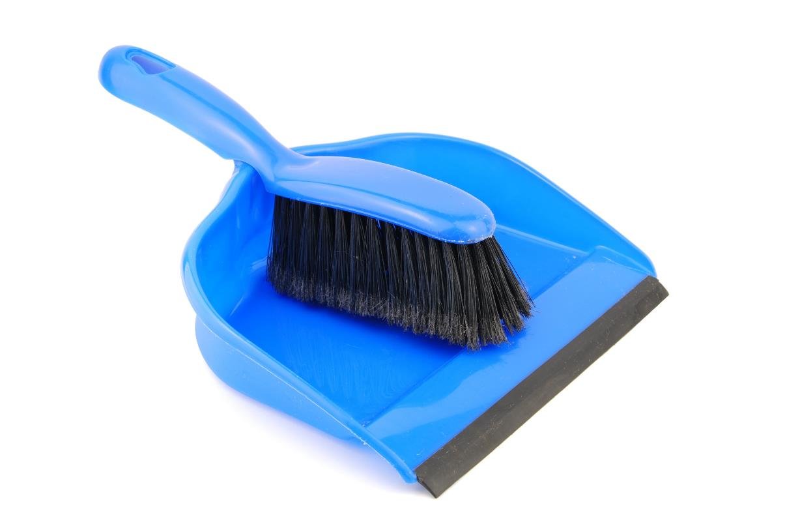
Clean Up
Notes:
You may wish to play a video or song during clean up time Link on GoNoodle: https://family.gonoodle.com/activities/clean-up. Link on YouTube Kids: https://www.youtubekids.com/watch?v=ZJFk87ZsHn0 . Link on Youtube: https://youtu.be/ZJFk87ZsHn0
Cleanup Pointers
• The sorting center and truck should stay assembled, but everything else should be taken apart.
• Check that the pieces from the LEGO® robot are returned to the LEGO set.

Slide 14
FIRST® and the FIRST® logo are registered trademarks of For Inspiration and Recognition of Science and Technology (FIRST). LEGO® is a registered trademark of the LEGO Group. FIRST® LEGO® League and CARGO CONNECTSM are jointly held trademarks of FIRST and the LEGO Group. All other trademarks are the property of their respective owners. ©2021 FIRST and the LEGO Group. All rights reserved.

